Slide 1
General Stakeholder Group
Q2 2019 Meeting
June 18, 2019 (1:30PM – 4:30PM)

Slide 2
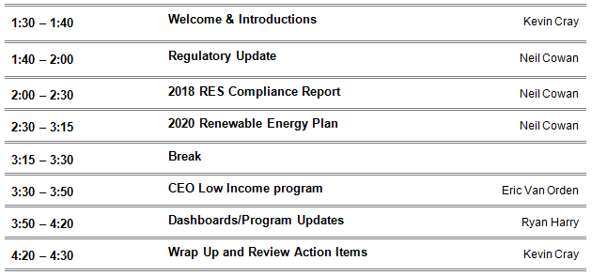
AGENDA
General Stakeholder Group

Slide 3
Regulatory Update
General Stakeholder Group
Rulemaking Status
Other filings:
  Electric Rate Case
  EV Tariff Filing
  Community Resiliency Initiative Filing
  Others???

Slide 4
2018 RES Compliance Report
General Stakeholder Group
Filed on May, 31 2019 and is now publically available
Notable sections for the SRC program include Attachments G and I

Slide 5
2020 Renewable Energy Plan
General Stakeholder Group
Planning to file on June, 28
Largely seen as a bridge plan with limited changes from the 2017 RE Plan
Next RES plan will align with the ERP cycle

Slide 6
Annual Solar*Rewards Program Capacity
General Stakeholder Group
S*R Program | Key Program Characteristics | 2019 (MW) | Recommended Capacity (MW)
 |  |  | 2020 | 2021
Small (<25 kW) | $0.005 / kWh – Retain Current REC Incentive Elimination of Option B (24 MW 2019) 12 Months – Retain Current Project Timeline Production meter costs follow system owner. | 24 (Option A) | 12 | 12
Small – CEO Res. Pilot – 300 Projects | $2/watt Installation & $0.034/kWh Incentive Funding from RESA. DOE funding up to $3,545/home | 200 (Projects Est.) | Carryover Pilot to Completion & Report Discuss options with CEO
Medium (25.01 – 500 kW) | $0.0375/kWh – Retain Current REC Incentive Moves 4MW to S*RC Std. Offer. Extend Project Timeline from 12 to 18 months. | 24 (6 MW Qtrly.) | 20 (5 MW Qtrly.) | 20 (5 MW Qtrly.)
Large (>500 kW) | Roll unused 2020 capacity to 2021. | 14 | Up to 14 | Up to 14
Total S*R S/M/L |  | 62 | 46 | 46

Slide 7
Annual SRC Program Capacity
General Stakeholder Group
S*RC Program | Key Program Characteristics | 2019 (MW) | Recommended Capacity (MW)
 |  |  | 2020 | 2021
Competitive RFP | Subscriber Mix Option to reinstate 5% Low Income requirement (Discuss with EOC) | 15 – Min 40 – Max | 15 35 | 15 35
Standard Offer | Takes 4 MW from Medium S*R program Increases project size from 100 to 500 kW Retains $0.02/kWh Adder Retains up-front Incentive for L/I Projects Allows for Diversity of Projects (Urban and Community) | 0.5 (Reg.) 0.5 (L/I) | 5 | 5
Low Income RFP | Continuation from 2017 RE Plan Option to be used for 5% L/I requirement. | 4 | 4 | 4
Company-Offered CSGs | Option for up to 5% of total incremental capacity of awarded capacity each year. | 2 (Low Income) | ~2 | ~2
Total S*RC |  | 46 | 46 | 46

Slide 8
Program Capacity Summary 2017 – 2021
General Stakeholder Group
Program Capacity Offered | 2017 | 2018 | 2019 | 2020 | 2021
Solar*Rewards Small Standard Offer | 24 | 24 | 24 | 12 | 12
Solar*Rewards Medium Standard Offer | 24 | 24 | 24 | 20 | 20
Solar*Rewards Large Competitive Bid | 6 | 10 | 14 | 20 | 20
Net Metering | 26 | 42 | 42 | 32 | 32
Subtotal On-site Solar | 89 | 118 | 128 | 82 | 82
Solar*Rewards Community Competitive Bid (Open & Low-income) | 31 | 36 | 41 | 39 | 39
Solar*Rewards Community Standard Offer (Open & Low-income) | 1 | 1 | 1 | 5 | 5
Company-owned Solar Gardens | 2 | 2 | 2 | 4 | 4
Subtotal Solar Gardens | 34 | 39 | 44 | 48 | 48

Slide 9
Dashboards

Slide 10
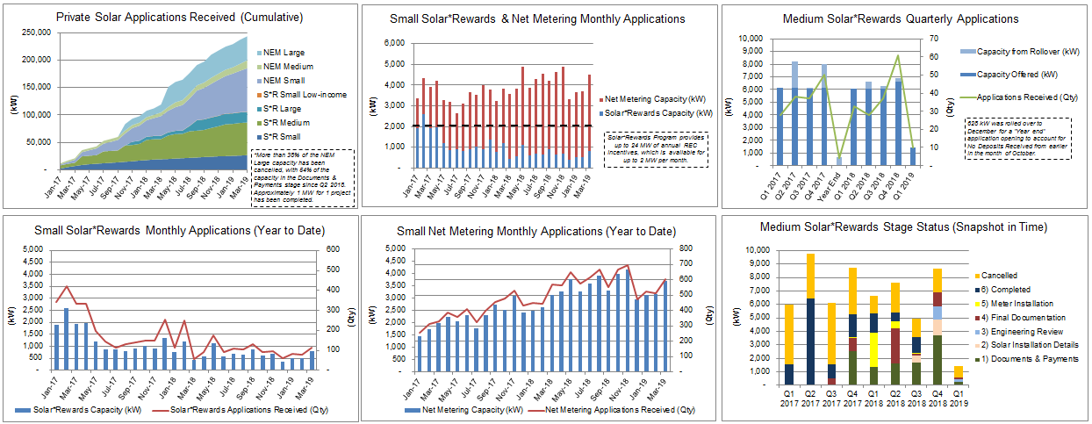
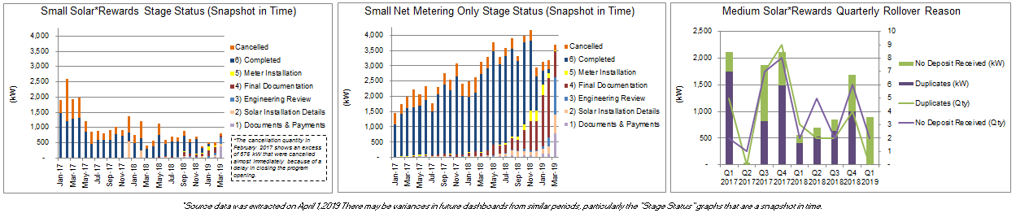
Solar*Rewards – Quarterly Dashboard
General Stakeholder Group

Slide 11
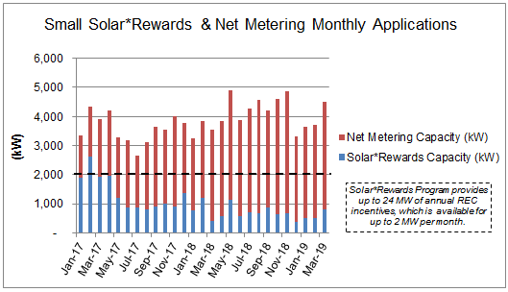
Solar*Rewards & Net Metering Only - Small
General Stakeholder Group
Participation in the Small Solar*Rewards program has continued to decline with under one Megawatt (MW) allocated for the past 10 months.
11

Slide 12
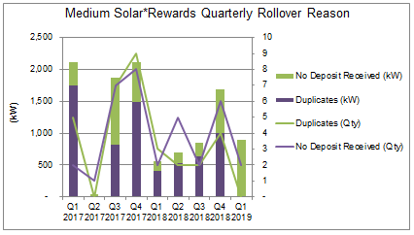
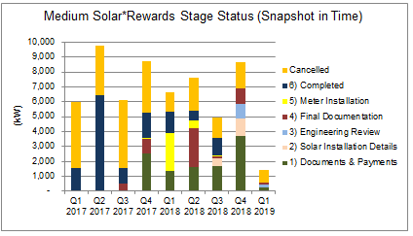
Solar*Rewards - Medium
General Stakeholder Group
Quarter one of 2019 was the second consecutive quarter that the Medium program didn’t sell out with 4.6 MW going unallocated and rolled into Q2.

Slide 13
On-site Storage
General Stakeholder Group
152 applications were received in 2017, 172 in 2018, and 108 YTD as of May, 31 2019. Of the completed applications ~93% are using configuration 2C Non-Export
Stage | Count of Product
Early Application (Documents, Installation Details, & Review) | 44
Pending Installation (Final Documentation & Meter Installation) | 72
Completed | 282
Grand Total | 398
*Source data was extracted on February 1, 2019. There may be variances in future dashboards from similar periods, particularly the "Stage Status" graphs that are a snapshot in time.
13

Slide 14
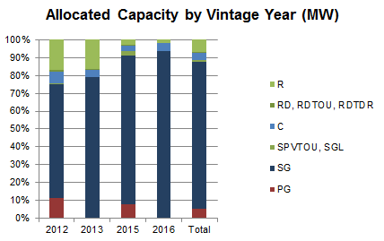
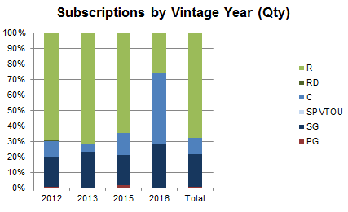
Solar*Rewards Community – Subscribers
General Stakeholder Group
Approx. 1,900 subscribers at the end of Q1 2019, with 9% of participation count including Low-income customers, 7% for Residential, 73% Municipality, 20% Schools & Biz
(Data includes operational projects from program start to March 31, 2019)

Slide 15
Solar*Rewards Community – Operational Status
General Stakeholder Group
15 MW has been added in 2019 and 30 MW more is expected by the end of the year
Status | Project sites | MW
Pre-Interconnection Study | 44 | 51.6
Construction | 17 | 27.3
Operational | 57 | 70
Totals | 118 | 149
(Data includes operational projects from program start to March 31, 2019)
15
Notes:
Over 80 MW opperational today

Slide 16
Other Program Topics
General Stakeholder Group
2019 Solar*Rewards RFP
2019 Solar*Rewards Community RFP
Solar Garden Sub-stakeholder Meeting

Slide 17

Low-Income Rooftop Solar Program
Ryan Harry
June 18, 2019

Slide 18

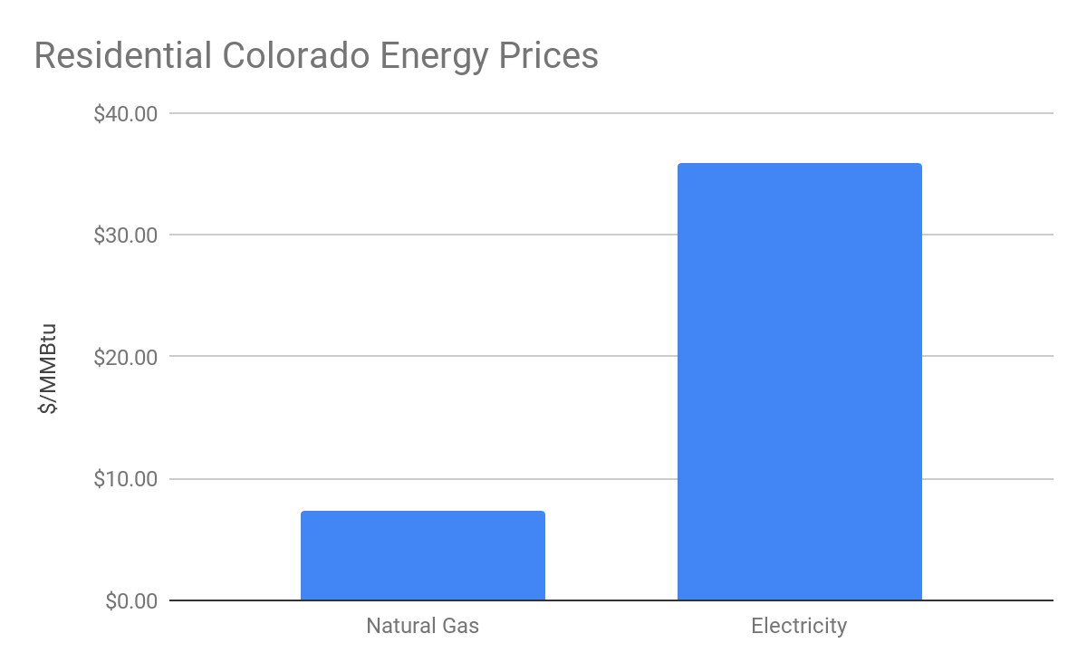
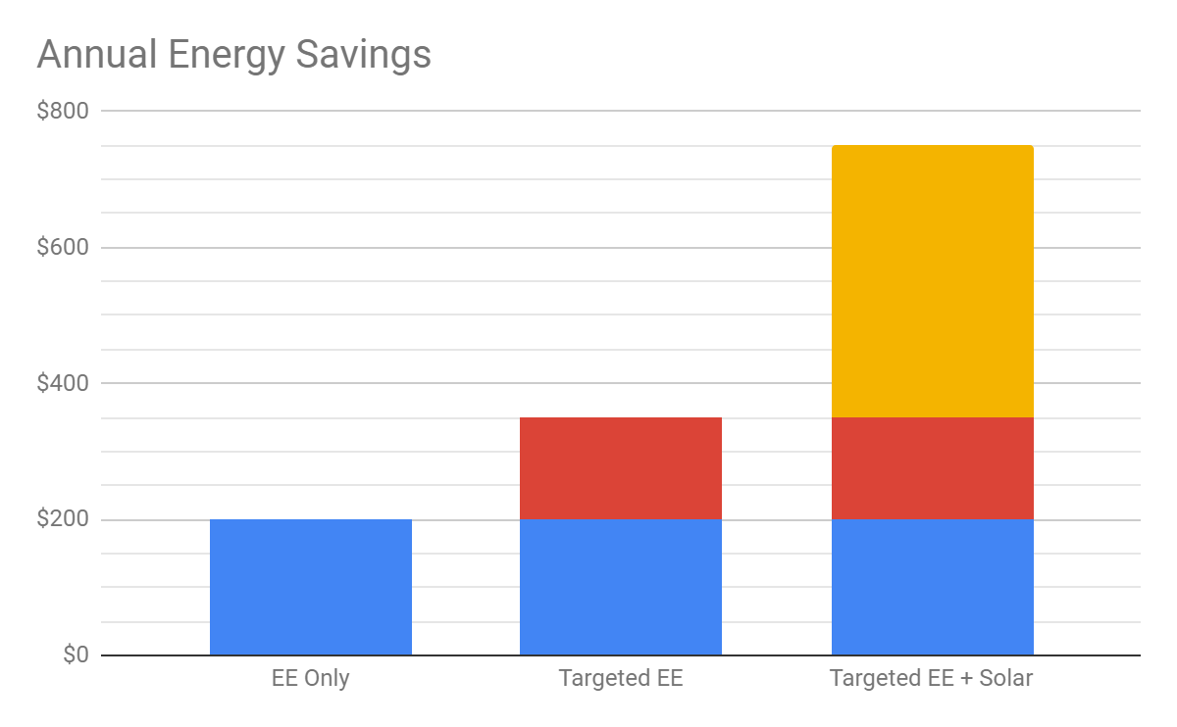
Colorado WAP Overview
Serve ~2,000 homes per year across all 64 counties
Goal: Maximize cost savings for EACH client served
Colorado WAP is a heating-only state, energy savings come from cheap gas
Want to include solar to increase cost savings beyond EE work
Solar Goal: Solar will be installed just like any other WAP measure

Slide 19
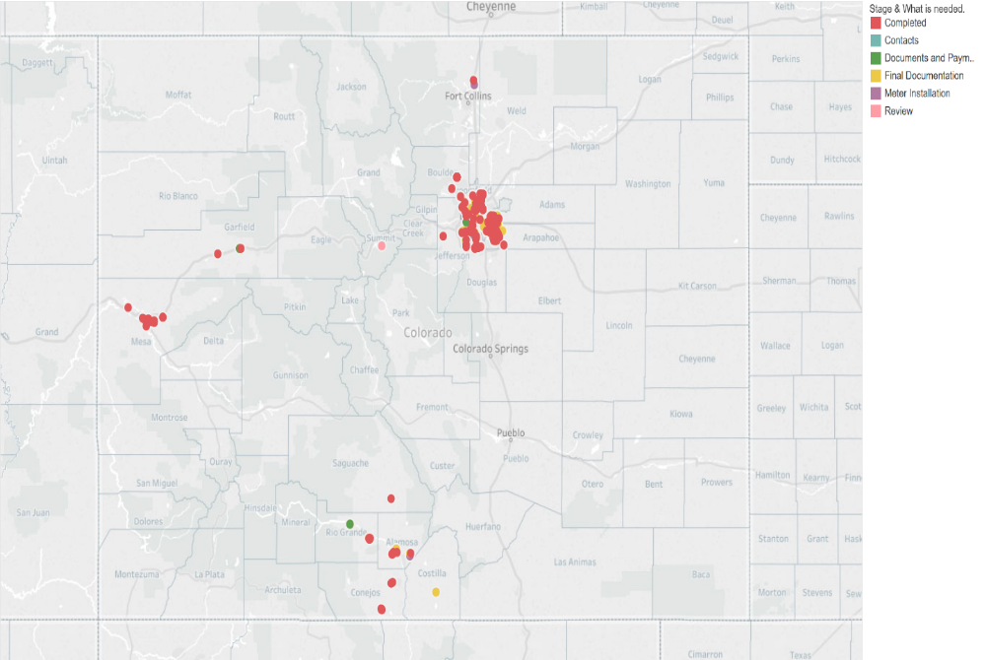

Slide 20
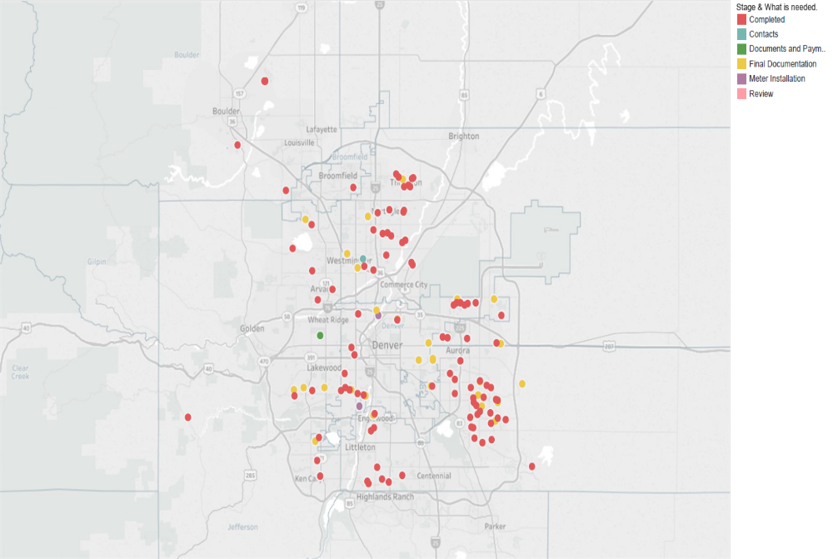

Slide 21
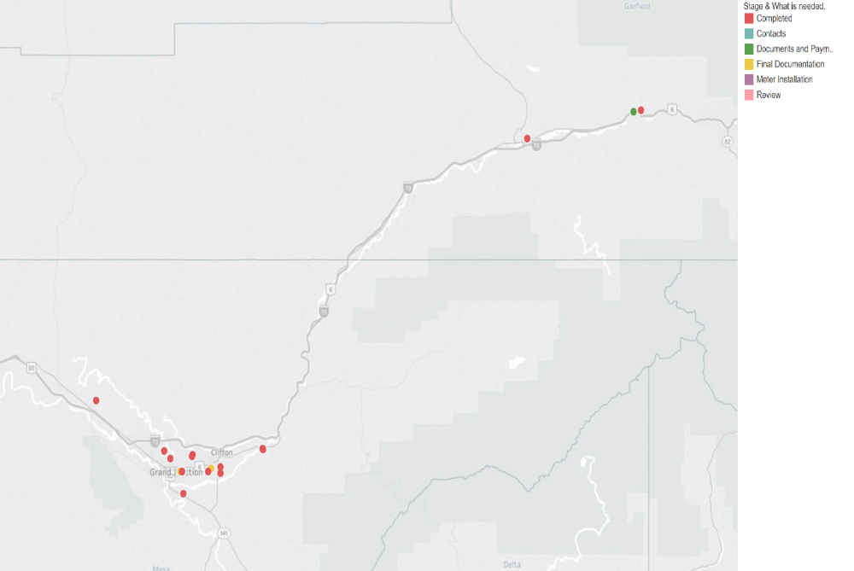

Slide 22
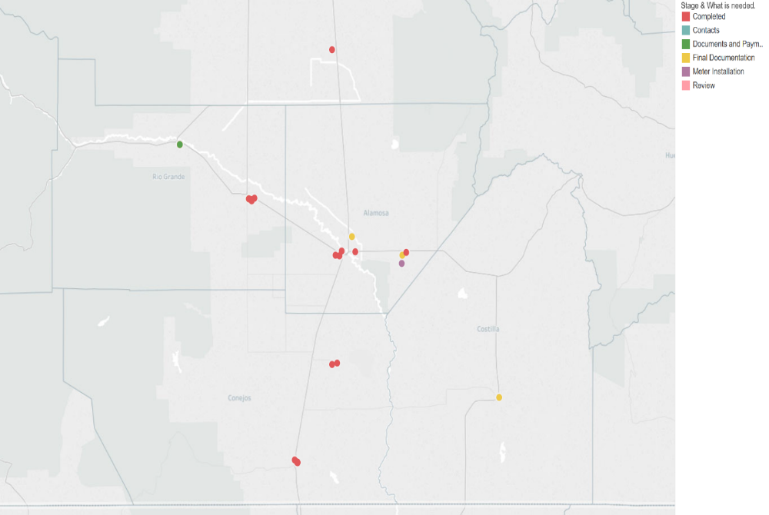

Slide 23
Program Performance Summary
 | As of 12/31/2018 | As of 5/31/2019
Systems Interconnected | 106 | 139
Systems in the Queue | 134 | 202
Average System Size (kW) | 3.0 | 3.0
Average System Cost | $8,696 | $8,848
Average Unit Cost ($/W) | $2.90 | $2.94
Average Annual Energy Offset (kWh) | ~4,200 | ~4,200
Average Annual Savings | ~$460 | ~$460

Slide 24
Q3/Q4 CY2019 Outlook
250+ expected to have engineering approval by 12/31/2019

Slide 25
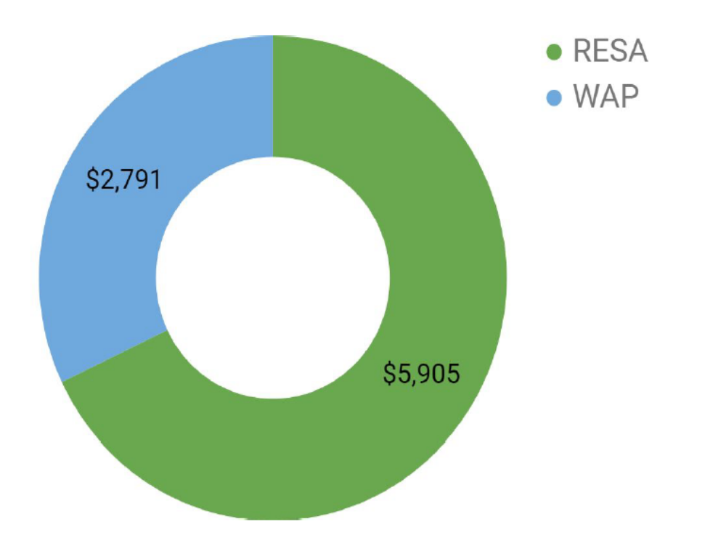
Funding Breakdown
2/3 RESA
1/3 WAP

Slide 26
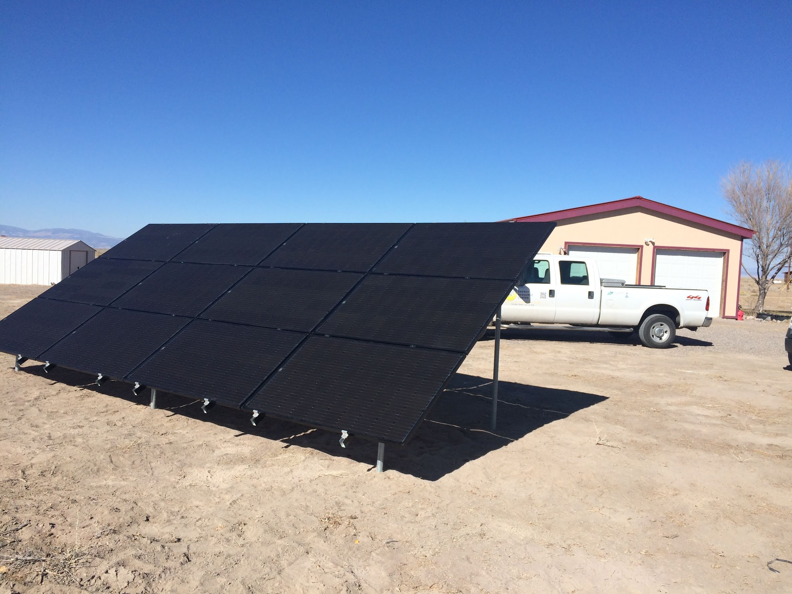
Challenges
Solar was a new measure for WAP
Installers are less interested in smaller systems
Long lead times from application to interconnection
The older homes that WAP tends to target often need electrical panel upgrades and roof repairs

Slide 27
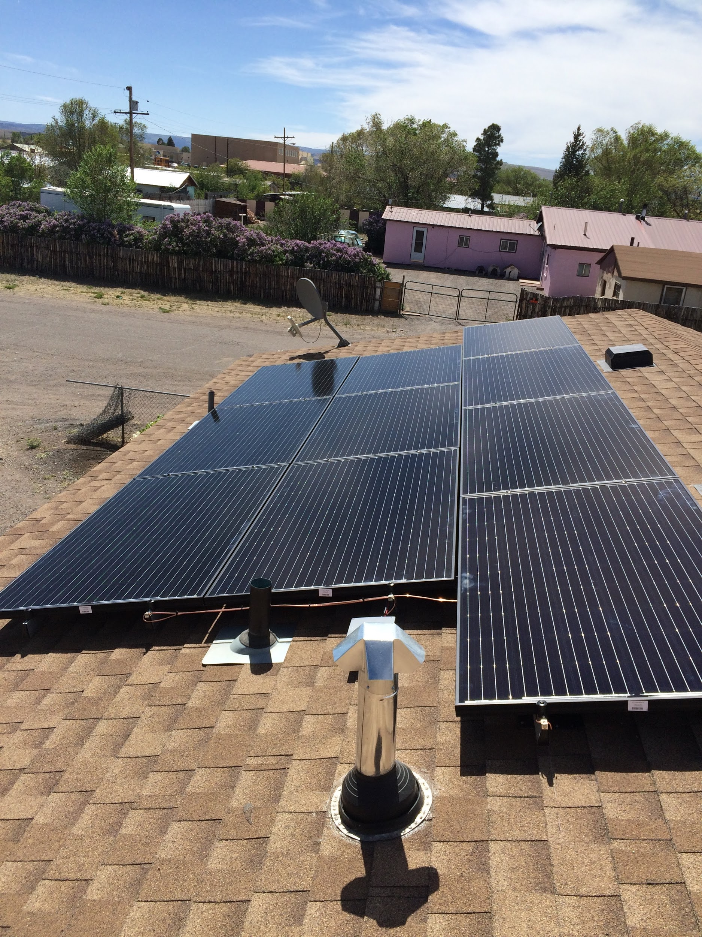
Big Wins
Colorado WAP now has a rooftop solar program!
Our service providers have learned how to deliver rooftop solar
One of our service providers has developed an in-house rooftop solar installation program
We’re able to save our clients an additional $450+ on energy bills each year

Slide 29


